Slide 1
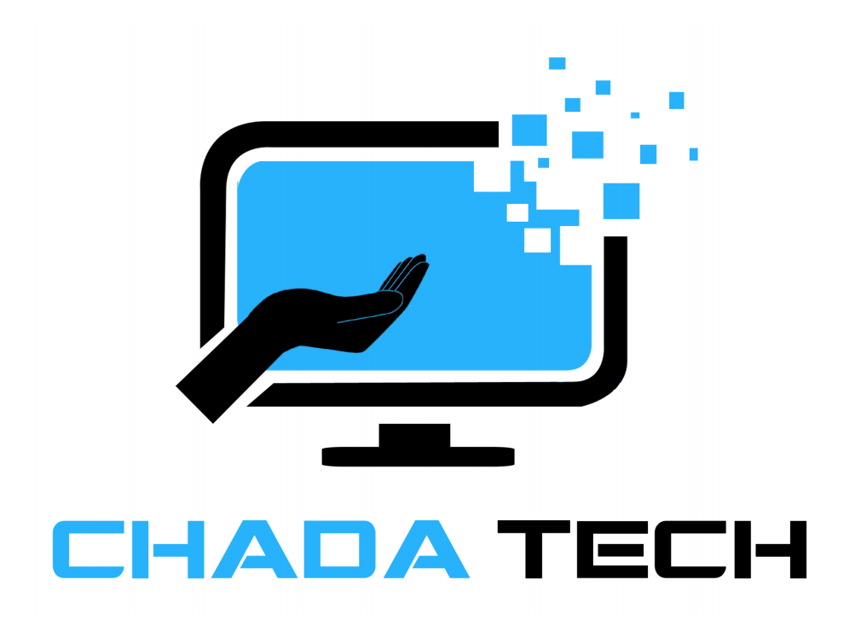
Agile Development
Scrum Master
Matthew Dziewiecki

Slide 2
Explaining the Scrum Agile Roles
The Product Owner
Explaining the product idea to the team
Manages the product and product backlog
Involves the stakeholders/end-users in backlog refinement/management.
Gathering and formulating user stories.
Gathering additional ideas from team members
The Scrum Master
Ensuring that the team collaborates towards successfully completing the project
Facilitating Scrum events
Assist with providing Agile knowledge to the team.
Time management
Manages Team culture and health
Ensuring that Scrum artifacts are in good order

Slide 3
Explaining the Scrum Agile Roles Cont.
Developers
Actively participating in the sprint planning to estimate development accurately.
Implement increments of new functionality across the development life cycle of a product.
Collaborating with the Agile tester during test case execution and assisting with finding any resolutions to any detected bugs or issues.
Testers
Collaborating with the product owner and stakeholders to clarify user stories and acceptance criteria.
Creating and executing test cases, focusing on both functional and non-functional requirements.
Plan and complete various aspects of the test strategy, such as exploratory testing, usability testing, and improving test coverage with the developers providing valuable feedback
Communicating test progress, issues, and risks to the team and stakeholders.

Slide 4
Explaining Agile Phases
The Agile approach to the Software Development Life Cycle (SDLC) consists of the phases of development that run in continuous loop. The loop is repeated for every phase of the product development. Typically, the SDLC begins with a plan and then fully ends once all features have been developed and the product is complete and delivered. An Agile approach considers each individual feature for its own cycle of development.
The features are broken down into “user stories” that are then developed during iterations called “sprints”. Each sprint consists of a circular path of phases that can be repeated until a feature, or a set of features are completed.
The Phases of the SDLC in Agile
Each phase of the Agile process is clearly defined and serves a purpose. The phases follow one another in a loop, and the loop can be repeated with new user stories as often as necessary to complete a project.

Slide 5
Waterfall Approach Vs. Agile Approach
Waterfall
Agile
Linear approach
Limited feedback
Changes require extra planning
Circular approach
Regular feedback
Easy to add/make changes
Considering a waterfall approach, the linear nature of this method requires most of the development be completed before any feedback is given. Changes to the product at this stage will mean more planning and redesign. In an Agile approach, features are developed by priority, and feedback is given incrementally throughout development. This allows the team to pivot quickly when changes need to be made, regardless of how large those changes may be. Where in a waterfall approach the entire product is given one cycle, the same product is broken into “stories” of features, each given its own cycle of the process. A waterfall is a long marathon, while Agile is a series of quick sprints.

Slide 6
When to choose Waterfall or Agile Approach
Waterfall Approach
Agile Approach
Relatively short time frame for delivery/development
Short feature list
Unlikely to change direction mid-project
Longer delivery time frame or more involved development
Long features list
Changing product features is likely
Agile demands a development team that is more self-sufficient and that communicates often with one another. While Agile is a more current approach to product development, the waterfall method remains helpful in many contexts and team arrangements.

Slide 7
References
Babik, D. (2022). Teaching Tip: Scrum Boot Camp: Introducing Students to Agile System Development. Journal of Information Systems Education, 33(3), 195–208.
Cecil Rupp. (2020). Scaling Scrum Across Modern Enterprises : Implement Scrum and Lean-Agile Techniques Across Complex Products, Portfolios, and Programs in Large Organizations. Packt Publishing.
Stray, V., Florea, R., & Paruch, L. (2021). Exploring human factors of the agile software tester. SOFTWARE QUALITY JOURNAL. https://doi-org.ezproxy.snhu.edu/10.1007/s11219-021-09561-2
Sinha, A., & Das, P. (2021). Agile Methodology Vs. Traditional Waterfall SDLC: A case study on Quality Assurance process in Software Industry. 2021 5th International Conference on Electronics, Materials Engineering & Nano-Technology (IEMENTech), Electronics, Materials Engineering & Nano-Technology (IEMENTech), 2021 5th International Conference On, 1–4. https://doi-org.ezproxy.snhu.edu/10.1109/IEMENTech53263.2021.9614779
Charles G. Cobb. (2015). The Project Manager’s Guide to Mastering Agile : Principles and Practices for an Adaptive Approach. Wiley.

